Slide 1
Issue Tracker
Iteration 3 / Final Presentation
Team 1

Slide 2
Contents
Requirements
Software Architecture / Design
Implementation
Testing
Process Improvement

Slide 3
Requirements
Deploy web app via Docker. (Iteration 1)
API Infrastructure: Routing of URLs. (Iteration 1)
Obtain issue details via GET request in API. (Iteration 1)
Adding comment to an existing issue via a PUT request in the API. (Iteration 2)
Setting up Amazon S3 for storage of files / attachments. (Iteration 2)
Fixing bug in current project: Enable description editing. (Iteration 2)
Fixing previous backlog. (Iteration 2)
Modifying single/multiple field(s) of an issue via PATCH request in API. (iteration 3)
Ability to attach files to comments. (Iteration 3)
Deploy chat client. (Iteration 3)
Creating new issue via Chat Client. (Iteration 3)
Adding comments to issue via Chat Client. (Iteration 3)
Modifying issue fields via Chat Client. (Iteration 3)

Slide 4
Software Architecture / Design
Use of Django Python Rest Framework to provide a web interface, handle requests and generate responses.

Slide 5
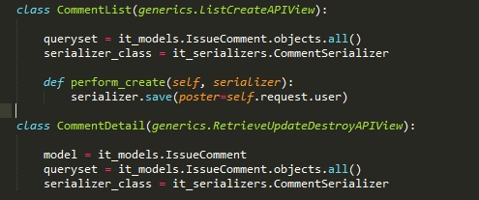
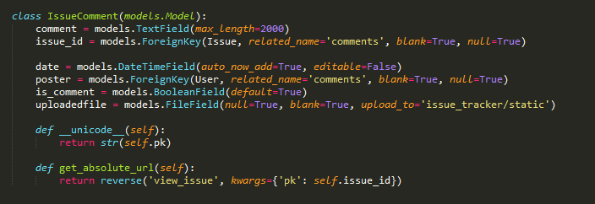
Adding Comment API

Slide 6
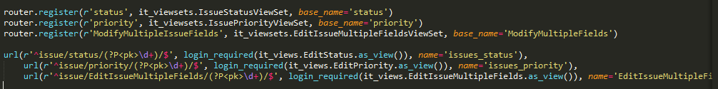
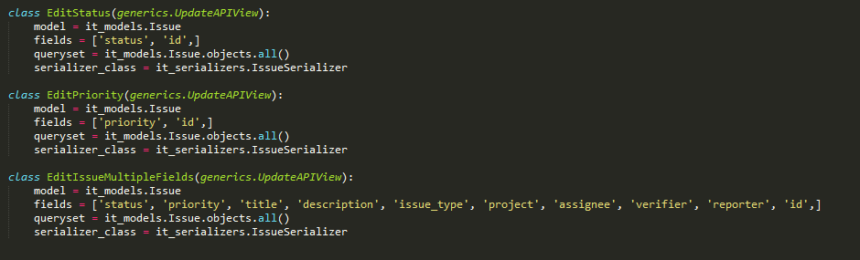
Modifying Issue API

Slide 7
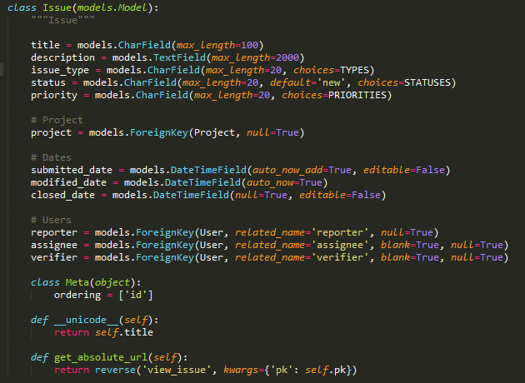
Modify Issue API Cont.

Slide 8
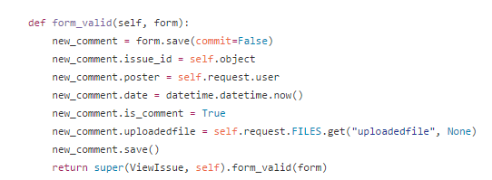
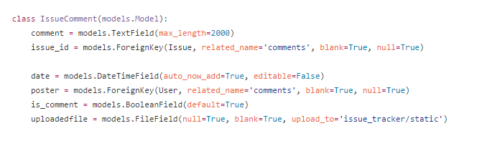
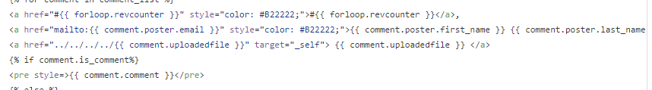
Attach File to Issue Comment

Slide 9
Implementation
Development Tools
Django
channels (Django Channels)
rest_framework (Django REST)
Python (standard)
Json
re (Regular Expressions)
Deployment Tools
Docker
Progress Management
Pivotal tracker
Version Control
Github
Collaboration Tools
Slack

Slide 10
Development and Deployment Environments
prior to this project…
developers all had their own development environments based on their operating system (windows, linux and OSX)
in some cases there were even differing envs depending on the version of operating system
deployment environment differs from many development environments
Python virtualenvs used in an attempt to achieve a common environment (e.g. focusing modules on a single interpreter). Problems with this approach include a lack of unified tooling (Bash, CMD, Powershell), and CPython modules create issues due to compiler differences, virtualenvs are mutable.

Slide 11
Other solutions
Virtual Machines?
heavy: final product is likely many GBs
not modular
not clear what went into the creation of the image after it has been created
does nothing to achieve idempotence

Slide 12
idempotence
REST: clients can make that same call repeatedly while producing the same result.
DevOps: the result of performing an operation once is exactly the same as the result of performing it repeatedly without any intervening actions.

Slide 13
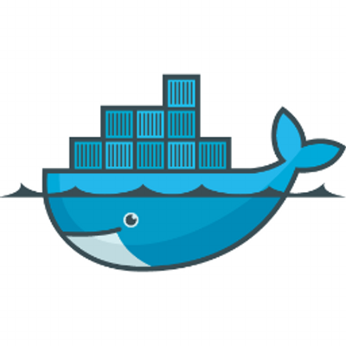
Docker
contains utilities specific to setting up an environment
not just for Python
libraries are packed in a container
true isolation of interpreter
containers can be tagged, published (pushed to Docker Hub), retrieved, built upon, used to create compositions
every developer, tester, config manager, deployment engineer is producing exactly the same environment
Dockerfile
# start with ubuntu v14.04
FROM ubuntu:14.04
# update aptitude with new repo
RUN apt-get update
# install python development libraries
RUN apt-get -y install python-pip python-dev
# readline dependencies
RUN apt-get -y install libncurses5-dev
RUN apt-get -y install libtiff5-dev libjpeg8-dev zlib1g-dev libfreetype6-dev liblcms2-dev libwebp-dev tcl8.6-dev tk8.6-dev python-tk
# install dependencies
ADD dependencies.txt /
RUN pip install -r dependencies.txt

Slide 14
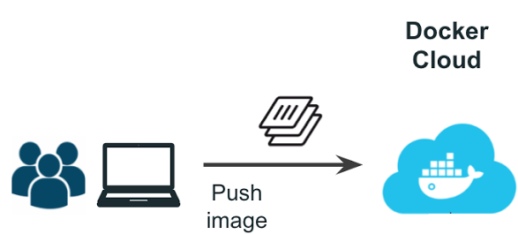
Docker Hub
docker build -t cs673/team_alpha_project_prereqs:0.0.1 ./
docker images
docker login
docker push cs673/team_alpha_project_prereqs:0.0.1

Slide 15
Django Channels
Ordered, first-in first-out queue with message expiration and at-most-once delivery to only one listener at a time.

Slide 16
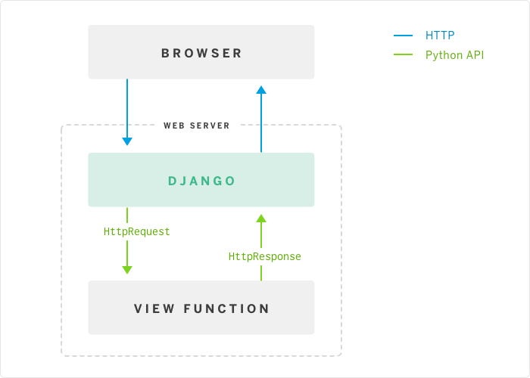
Traditional website communication cycle: request/response

Slide 17
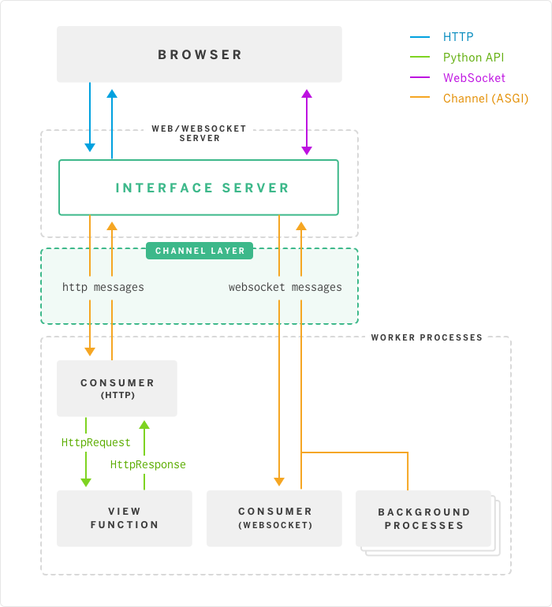
Event oriented channels
modern web includes WebSockets and HTTP2 server push
Django responds to a wide array of events sent on channels
no persistent state - each event handler (consumer) is called independently in a way much like a view is called
messages are put onto the channel by producers, and then given to just one of the consumers listening to that channel

Slide 18
requirements
Imported modules:
channels>=0.10
asgi_redis>=0.9
Defined modules:
consumers.py: connect WebSocket to channel session channel session, put WebSocket data onto channel, unsubscribe WebSocket from rooms, add user to chat room, remove user from chat room, send data from user in room, parsing messages, etc.
routing.py: join, leave, send with regard to rooms
serializers.py: RoomSerializer (messages must be made of serializable types)

Slide 19
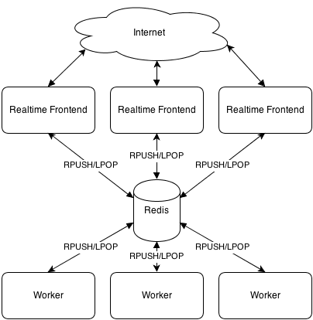
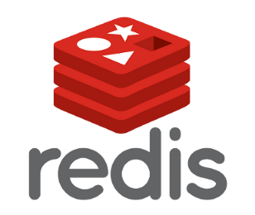
Channel layer
Redis: the recommended backend to run Channels with, as it supports both high throughput on a single Redis server as well as the ability to run against a set of Redis servers in a sharded mode.

Slide 20
channel layer setup
# settings.py
redis_host = os.environ.get('REDIS_HOST', 'localhost')
CHANNEL_LAYERS = {
"default": {
"BACKEND": "asgi_redis.RedisChannelLayer",
"CONFIG": {
"hosts": [(redis_host, 6379)],
},
"ROUTING": "chat.routing.channel_routing",
},
}

Slide 21
Environment configuration
docker-compose.yml:
version: "2"
services:
redis:
image: redis:latest
team_alpha_project:
build: .
command: python manage.py runserver 0.0.0.0:8000
ports:
- "8000:8000"
links:
- redis

Slide 22
Refactoring
throw out old Chat (communication) application
throw out unused Chat code from multiple classes prior (comm and communication/comm)
throw out deploy_tools directory
relocate (throw out?) project_router functionality
move dependencies files into docker subdirectory
reformat old Django code to comply with PEP 8 (Style Guide for Python Code) conveniently enforced by PyCharm
organize documentation moving all of documentation into single directory and categorize by semester

Slide 23
Integrating Chat Client with Issue Tracker
Intercept user message in WebSocket handling code
Parse message for special action indicators and arguments
Regular expression processing for “Slack-like” command strings (starting with “/”):
Create new issue and comments in database
/new-issue
/issue-comment
Modify existing issues
/set-issue-status
/set-issue-priority
/set-issue-type

Slide 24
Integrating Chat Client with Issue Tracker (cont’d)
Capture arguments to the command, also with regexes
Ex.) /issue-comment:
".*issue=(?P<issue_id>[0-9]+).*comment=\'(?P<comment>[^\']+)\'"
Dispatch captured data to Issue model functions to get, create or update
Raise error messages in the client for malformed requests
Ex.) Invalid parameters used with the /issue-comment command. Requires “issue=id” and “comment='comment text'”
“Muted” messages piped to message list
Summary of the action that the user took via the chat client
Visible to all users in a room, but not attributed to a user like normal messages

Slide 25
Example: Edit Issue Status
issue_status_pattern = re.compile(r"/issue-status")
issue_status_match = issue_status_pattern.match(message["message"])
if issue_status_match:
print "Chat input matched prefix '/issue_status'"
issue_pattern = re.compile(r".*(issue|name)=\'(?P<issue>[^\']+)\'")
issue_match = issue_pattern.match(message["message"])
if issue_match:
print "Chat input matched parameter on 'title' or 'name'"
# Do special handling
issue = issue_match.group('title')
new_issue = it_models.Issue(issue=issue, reporter=message.user)
new_issue.save()
print "New issue #{0} ({1}) submitted via chat client by user {2}".format(issue_status.pk, issue_status.issue,
message.user.username)
issue_submit_msg = "{0} submitted a new issue to the tracker: Issue #{1}, Title: {2}".format(
message.user.username, new_issue.pk, new_issue.title)
room.send_message(issue_submit_msg, message.user, MSG_TYPE_MUTED)
else:
raise ClientError(
"Invalid parameters used with the /new-issue command. Try <title='foo'> or <name='bar'>")
else:
# Send the message along
room.send_message(message["message"], message.user)

Slide 26
Security: Token-based HTTP authentication
Include Django’s REST framework token authentication module among installed applications in settings.py:
INSTALLED_APPS = ( ... 'rest_framework.authtoken' )
Include default permission and authentication classes in settings.py:
REST_FRAMEWORK = {
'DEFAULT_PERMISSION_CLASSES': (
'rest_framework.permissions.IsAuthenticated',
),
'DEFAULT_AUTHENTICATION_CLASSES': (
'rest_framework.authentication.TokenAuthentication',
)
}

Slide 27
Create tokens for users
# ./signals.py
from django.db.models.signals import post_save
from django.dispatch import receiver
from rest_framework.authtoken.models import Token
from django.conf import settings
@receiver(post_save, sender=settings.AUTH_USER_MODEL)
def create_auth_token(sender, instance=None, created=False, **kwargs):
if created:
Token.objects.create(user=instance)
And, make sure this gets imported (perhaps in ./__init__.py)
import signals

Slide 28
Create url route to retrieve token
# ./urls.py:
from rest_framework.authtoken import views
urlpatterns = patterns(
…
url(r'^api-token-auth/', views.obtain_auth_token)
)

Slide 29
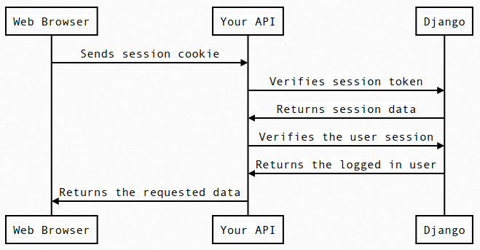
Token-based REST request call sequence

Slide 30
Remotely hosted static content
imported modules:
django-storages==1.5.1
boto==2.43.0
defined modules:
custom_storages.py: set static storage location to S3 bucket subdirectory, set media files location to S3 bucket subdirectory
settings.py:
add 'storages' to installed applications
define static storage location, media files location, AWS header, bucket, AWS access id & secret access key

Slide 31
AWS hosted content continued...
in AWS:
modify S3 bucket policy to allow access to data subdirectory content for user with ARN matching id/key pair above
set up is CORS. CORS defines a way for client web applications that are loaded in one domain to interact with resources in a different domain.
refactor templates to use static Jinja2 variable
move static data to S3:
# Dockerfile
RUN python manage.py collectstatic

Slide 32
QA Process
Iteration 1
Work Done:
Explore code and App and try to get an idea of testing efforts
Issues:
Getting the existing Application up and running
Iteration 2
Work Done:
Get existing UI automation running and add to it
Write Manual Test Cases
Issues:
Update to Firefox web browser
Switched to Chrome web browser
Store ChromeDriver in app
Different implementations of existing Automation
Iteration 3
Work Done:
Add API Automation
Issues
Understanding to Django REST Test Utilities
Keeping up with development

Slide 33
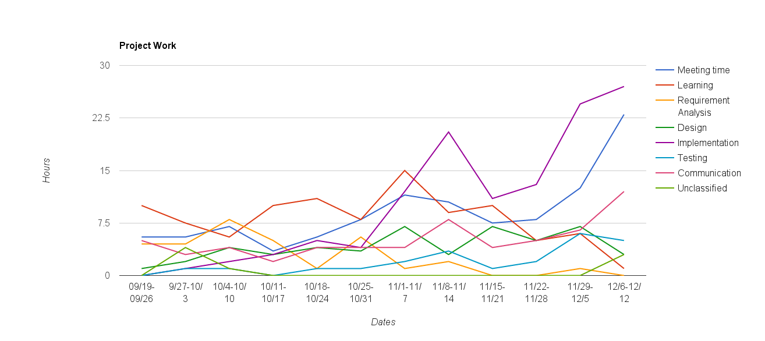
Metrics - Project Hours - Report

Slide 34

Metrics - Commits
Iteration 1 - 10/4 to 10/24
2
Iteration 2 - 10/25 to 11/14
5
Iteration 3 - 11/15 to 12/12
54
Total Files Modified
4,747 changed files with 5,870 additions and 570,488 deletions.
Github Link

Slide 35
Metrics - Test Coverage
Iteration 1
Unit Tests | UI Automation Tests | Manual testing | API Tests | Bugs
- 0 | - 6 inoperable | - 0 | - 0 | - 0
Iteration 2
Unit Tests | UI Automation Tests | Manual testing | API Tests | Bugs
- 0 | - 4 inoperable - 2 Passing | - 5 Passing - 1 Failing | - 0 | -1 Edit Issue Description (Fixed)
Iteration 3
Unit Tests | UI Automation Tests | Manual testing | API Tests | Bugs
- 0 | - 5 Passing | - 15 Passing | - 13 Passing | - 1 Unable to Messages in chat(Fixed)
Test Plan Link

Slide 36
Process
Agile process model with 3 iterations.
Agile methodology ensuring active participation of all members from the start of every iteration.
Priorities:
Iteration 1: Learning Django RESTframework and understanding working of previous project.
Iteration 2: Getting some hands-on development experience starting with smaller user stories.
Iteration 3: Based on previous iterations implement all user stories and deliver the product.
Adoption of paired programming from iteration 2 based on the lessons learnt from previous iteration.

Slide 37
Final Product
Open API
A mobile application or external website could integration to the issue tracker
Token-based authentication for users = safer environment
Improved internal integration
Create and edit issue tracker data from with simple chat client messages
Communication tool running on same backend as issue and requirements trackers
Ease of deployment
Simplification of the deployment of this software
Easier to host centrally, or to distribute for local or in-house installations

Slide 38
Demo

Slide 39
Thank you.

